Slide 1



Pierce Transit
Comprehensive Route Network Analysis

Slide 2
Agenda
Existing market assessment
Existing service assessment
Board and public priorities for service
Expansion Alternative 1
Expansion Alternative 2
March 2017 Service Change – status quo or restructure
Next Steps

Slide 3
Market Assessment Conclusions
Elements assessed:
Population and employment densities
Socio-economic factors
Market assessment indicates service is in areas where it needs to be based on land use

Slide 4
Service Evaluation Conclusions
Most routes are average
Strong dependence on transfers
Route structure is designed for timed transfers, but scheduling and frequency no longer support that
Duplication of service
Span of service is inadequate for many trip types

Slide 5
Board Priorities
Overarching Goal: Improve ridership
Attract more discretionary riders & commuters
Tradeoff Preferences:
Improve service in high ridership areas
No clear direction on span vs. frequency
Improve service on weekdays
Reduce transferring
Improve route directness
Longer stop spacing

Slide 6
Public Priorities

Slide 7
Alternative 1 – Expansion Priorities
Maintain existing route network to minimize impacts on existing customers
Responding to Board and Public Priorities, prioritize investment in frequency to boost convenience and ridership
Insufficient resources are available to meaningfully expand route frequency and span of service
Projected Result: Improved Ridership

Slide 8
Alternative 1 – Expand Existing Network
Add 35,000 hours to Existing Network
All urban routes have 30 minute weekday peak service
Improve midday weekday service on most urban routes
Urban routes without 30 minute midday service:
11, 51, 53, 206
No routes with expanded span

Slide 9
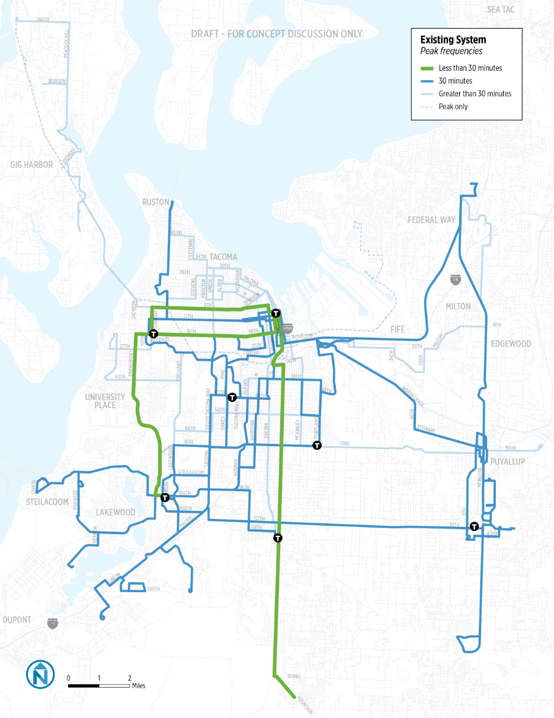
Alternative 1- Expand Existing Network
Weekday Peak Frequency Improvements
w/ 35k

Slide 10
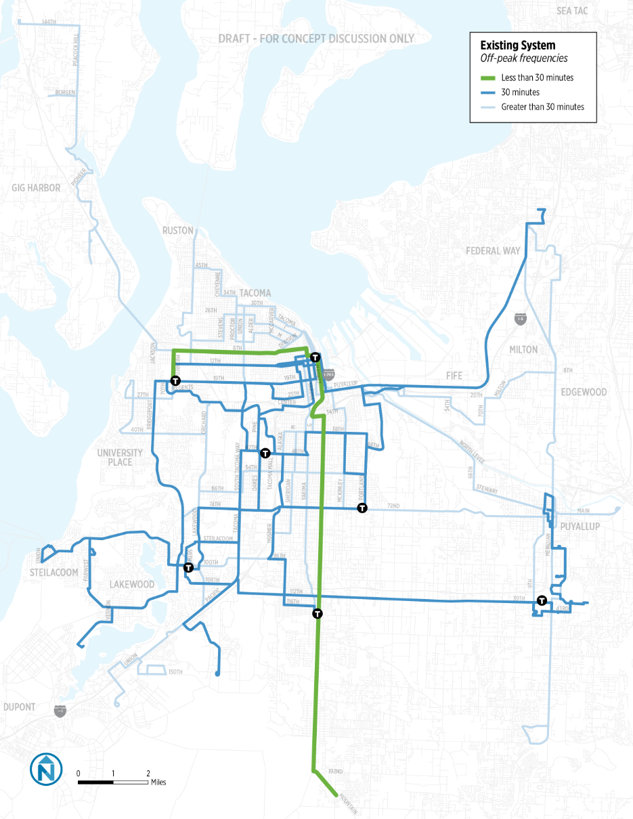
Alternative 1 – Expand Existing Network
Weekday Midday Frequency Improvements
w/ 35k

Slide 11
Alternative 1
Proposed System Map
Span and Frequency Enhancements
All urban routes have 30 minute peak service
Most urban routes have 30 minute midday service
No routes with expanded span

Slide 12
Alternative 2 - Restructure Priorities
Responding to Board and Public Priorities, invest in frequency and span of service to boost convenience and ridership
Themes of restructuring
Simplify service
Reduce duplication
Improve peak and midday frequency on key routes
Improve access to key destinations
Minimize coverage losses
Projected Result: Improved Ridership
More than Alternative 1

Slide 13
Alternative 2 – Restructure & Added Service
Summary of Improvements
Restructured Network with 35,000 Hours
Restructure network and add 35,000 Hours of service
All urban routes have 30 minute peak service
All urban routes have 30 minute midday service
Route 402 has both 30 minute midday and peak service
All urban routes have service to 10 p.m. and Routes 3 and 4 have expanded span

Slide 14
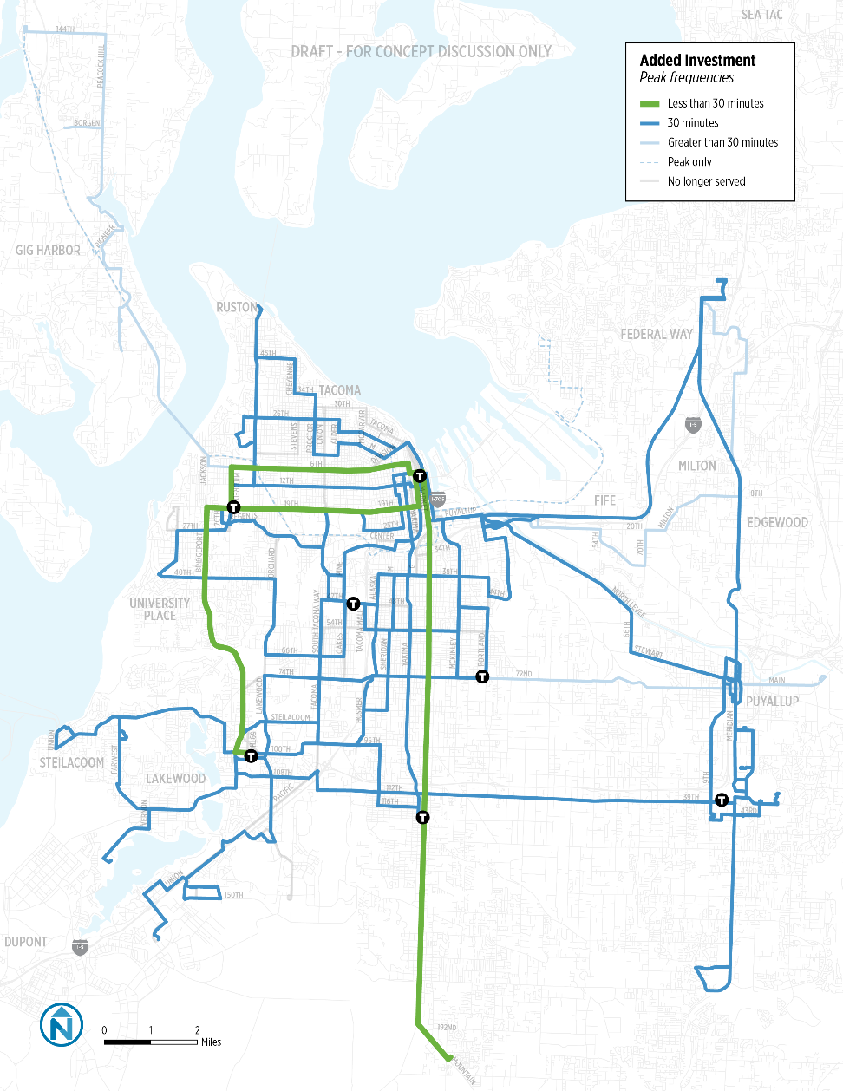
Alternative 2 – Restructure & Added Service
Weekday Peak Frequency Improvements
w/ 35k

Slide 15
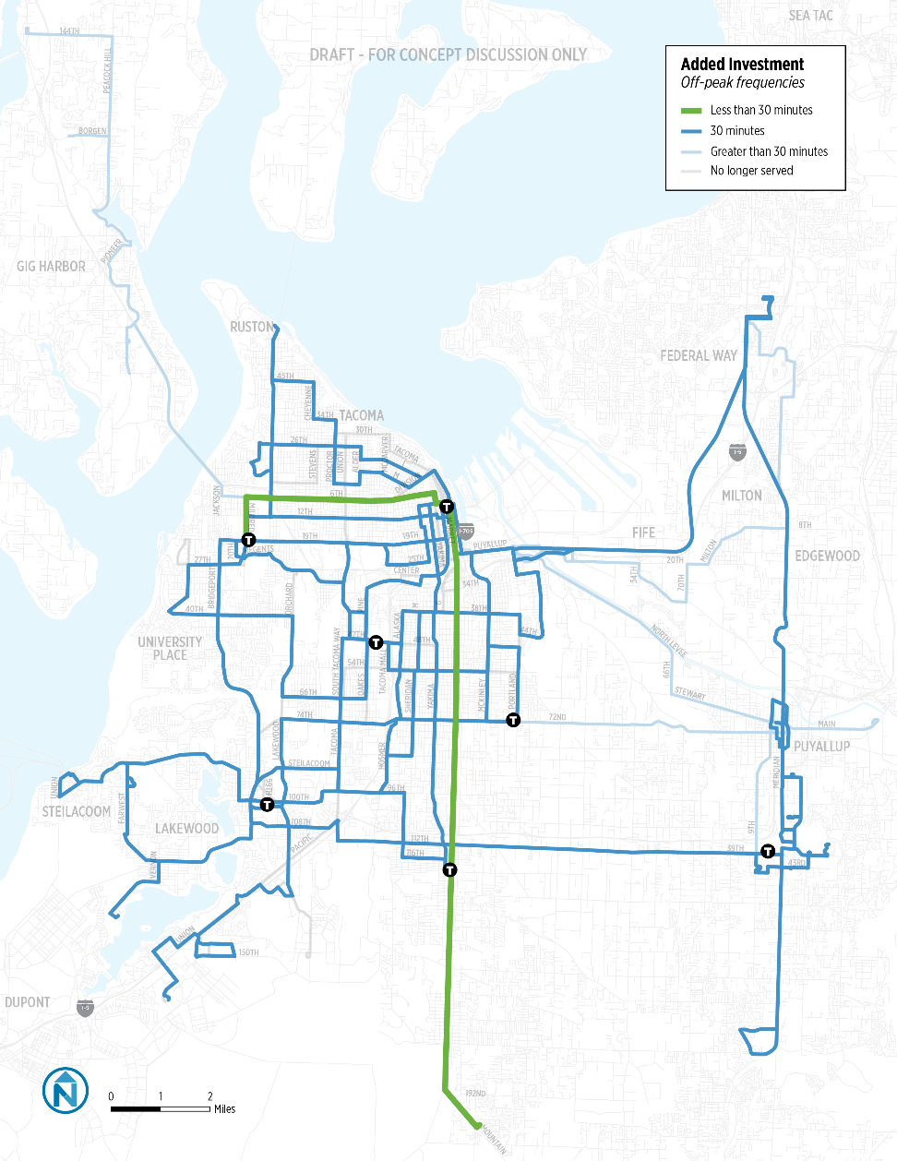
Alternative 2 – Restructure & Added Service
Weekday Midday Frequency Improvements

Slide 16
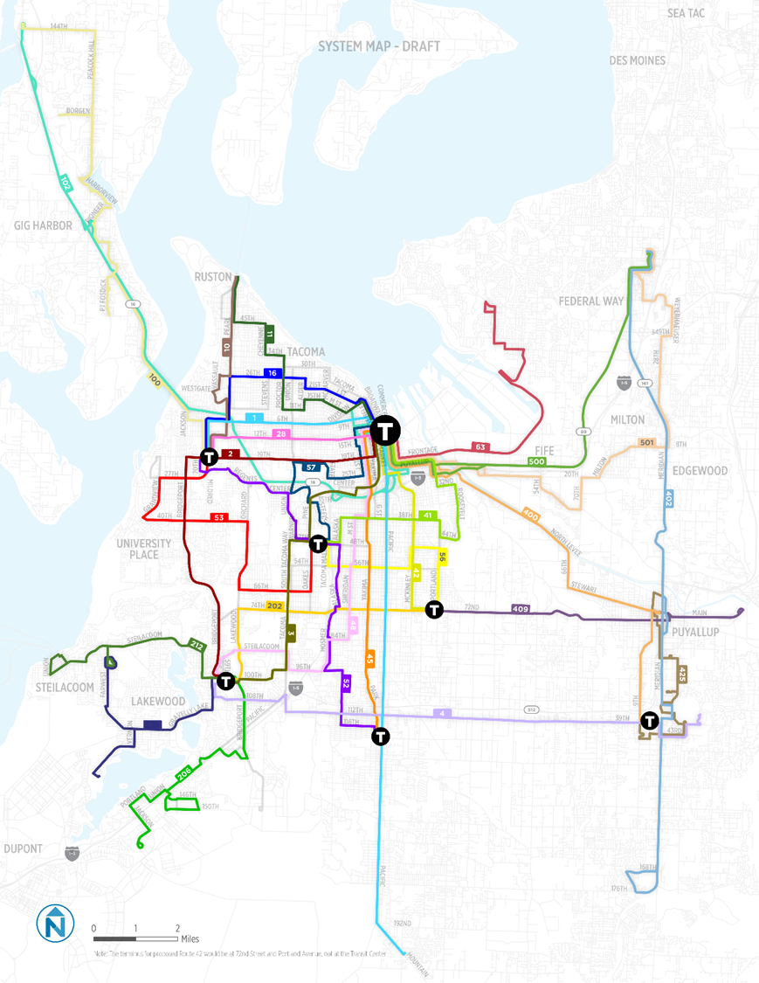
Alternative 2
Proposed System Map
Span and Frequency Enhancements
All urban routes have 30 minute peak service
All urban routes have 30 minute midday service
Route 402 has both 30 minute midday and peak service
All urban routes have service to 10 p.m. and Routes 3 and 4 have expanded span
214

Slide 17
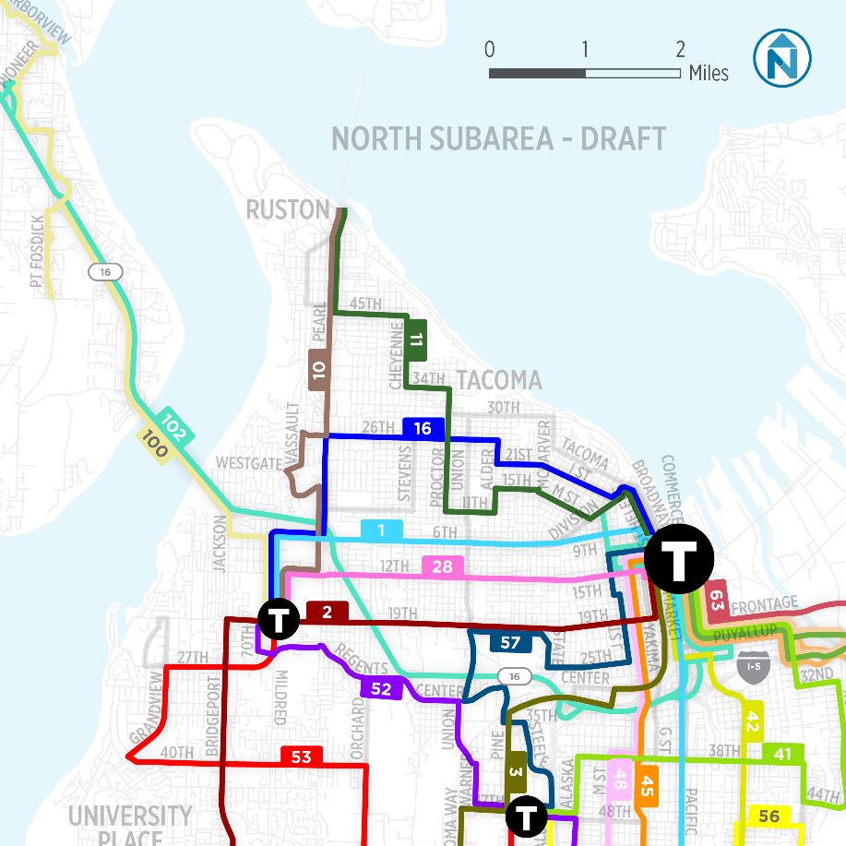
Alternative 2 – Restructure & Added Service
North Tacoma Summary
Operate consolidated routes later and more frequently
North Proctor and Stadium District is connected to Downtown Tacoma with 15-minute service
Old Town could be served by new Trolley service to Ruston

Slide 18
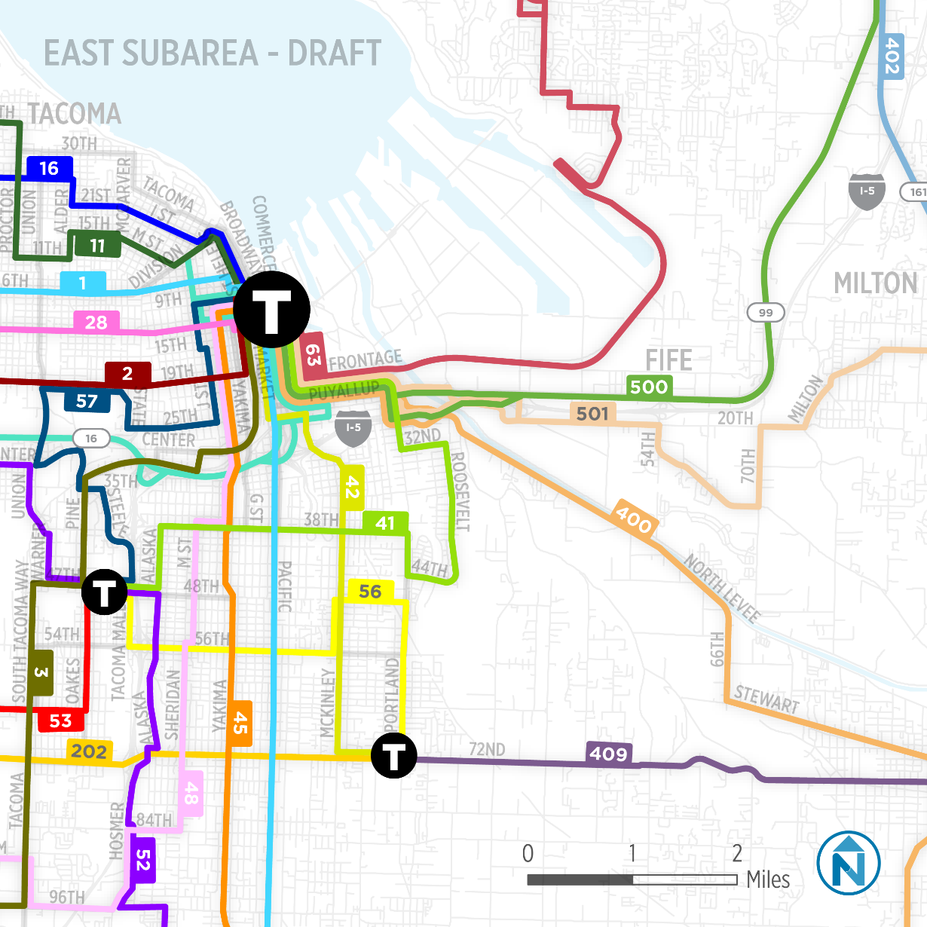
Alternative 2 – Restructure & Added Service
East Tacoma Summary
Consolidate services and create interlined East Tacoma grid
Operate consolidated routes later and more frequently
Create 15-minute service corridor on Yakima between downtown Tacoma and 38th Street

Slide 19
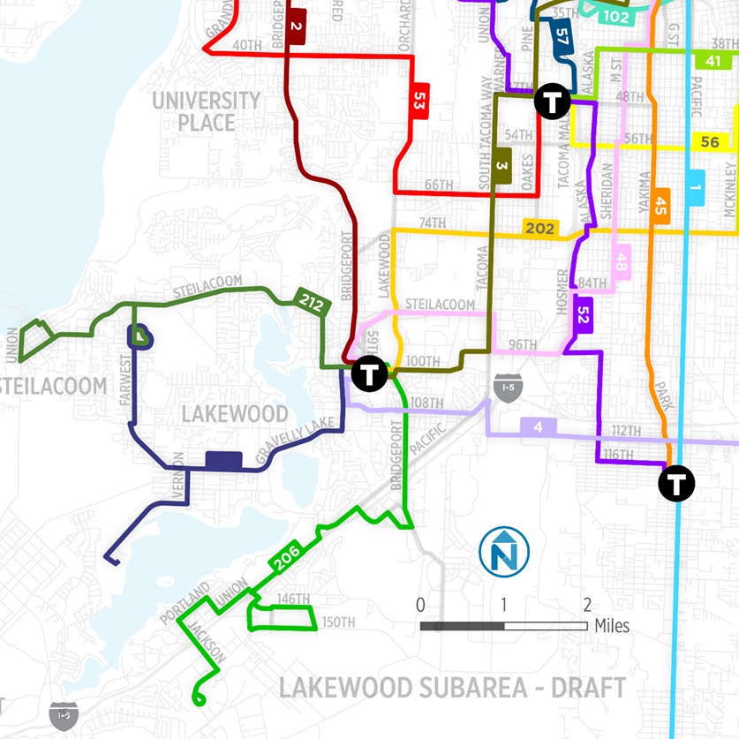
Alternative 2 – Restructure & Added Service
Lakewood Summary
Operate routes later and more frequently
Adjust Route 3 to serve highest potential ridership corridor between Lakewood and Tacoma
Consolidate routes to JBLM
Remove less utilized cross-town to North Tacoma
214

Slide 20
Comparison of Alternatives
Alternative 1: Expanded Existing Network
All urban routes have 30 minute peak service
Most urban routes have 30 minute midday service
No routes with expanded span
Alternative 2: Restructure and Added Service
All urban routes have 30 minute peak and midday service
Route 402 improved to 30 minute midday service
All urban routes have service to 10 p.m.
Summary:
Maximizes coverage, but much of network is infrequent and without evening service
Summary:
Some existing ridership patterns change, but most of the network operates later and more frequently

Slide 21
Alternative 2 is Recommended
Better meets board and public priorities of improving frequency and span of service
Higher potential for immediate and sustained ridership gains
Allows for cost effective expansion of weekend frequency and span of service
Sets table for corridor investment between Lakewood, Tacoma Mall, and downtown Tacoma

Slide 22

Refine Draft Recommendations Sept / Oct
Board Study Session Oct. 10
Public Outreach October
Public Hearing on Pref. Alternative / Title VI Nov. 14
Refinements if needed November
Board Adoption Dec. 12
Scheduling / Permitting December
Schedules Finalized Dec. 22
Service Implemented March 12

